Slide 1
HEALTH SUPERVISOR APP
PRESENTED BY:
MOHD MANSOOR SHAREEF
(17841A05A2)

Slide 2
TABLE OF CONTENTS
01.
02.
03.
04.
ABSTRACT
EXISITING SYSTEM
DISADVANTAGES
05.
06.
PROPOSED SYSTEM
ADVANTAGES
MODULES
07.
08.
09.
ALGORITHM
ARCHITECTURE
UML DIAGRAM
10.
11.
12.
OUTPUT
HARDWARE REQUIREMENT
SOFTWARE REQUIREMENT
13.
14.
15.
LITERATURE SURVAY
FUTURE SCOPE
CONCLUSION

Slide 3
ABSTRACT
Our application would interact with the users in the same way the physically present doctor does. It asks for the symptoms from the user and processes those inputs and gives the health issue as the output to the user, So according to that particular health problem the user can plan the treatment. We are using a API named Infermedica to process the symptoms and predict the health disease and the send the data back to the application. Apart from just predicting the diseases we have added an addition feature of viewing the latest news on health related issues, And also reminders are also implemented so that the user can take the medications on time.

Slide 4




Existing System
These are few well known android applications
Samsung
Health
Google Fit
Clickastro
Health
Predictor

Slide 5
Disadvantages
Prediction applications have very less accuracy and also they are not so efficient
There is no free android app which predicts the disease based on your symptoms
Requires latest model of mobile device to run
Most of them have complex UI (User Interface)

Slide 6
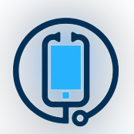
Proposed System
Health supervisor
Health supervisor provides diagnosis of user based of symptoms, provides latest real world news related to health issues and reminders so user can take medicine on time

Slide 7
Advantages
Health Supervisor provides accurate prediction as it predicts using symptoms , age and gender of the patient
It has interactive user interface
Can run on all android devices which has android version lollipop
Apart from just predicting the diseases we have added an addition feature of viewing the latest news on health related issues
It also provides reminder so that the user can take the medications on time

Slide 8
User Interface
Animation used in our app
Android Spinkit
WaveView
Android particles
ShowcaseView

Slide 9
Modules

Slide 10
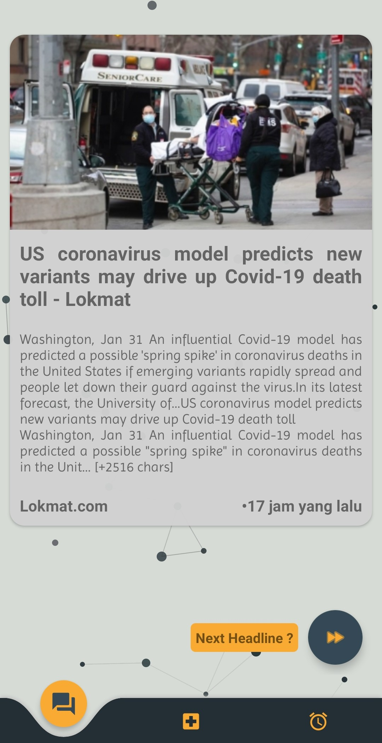
Module 1
Headlines Activity
News Page
This Feature displays latest new related to health
Next Headline
This button is used to see next headling

Slide 11
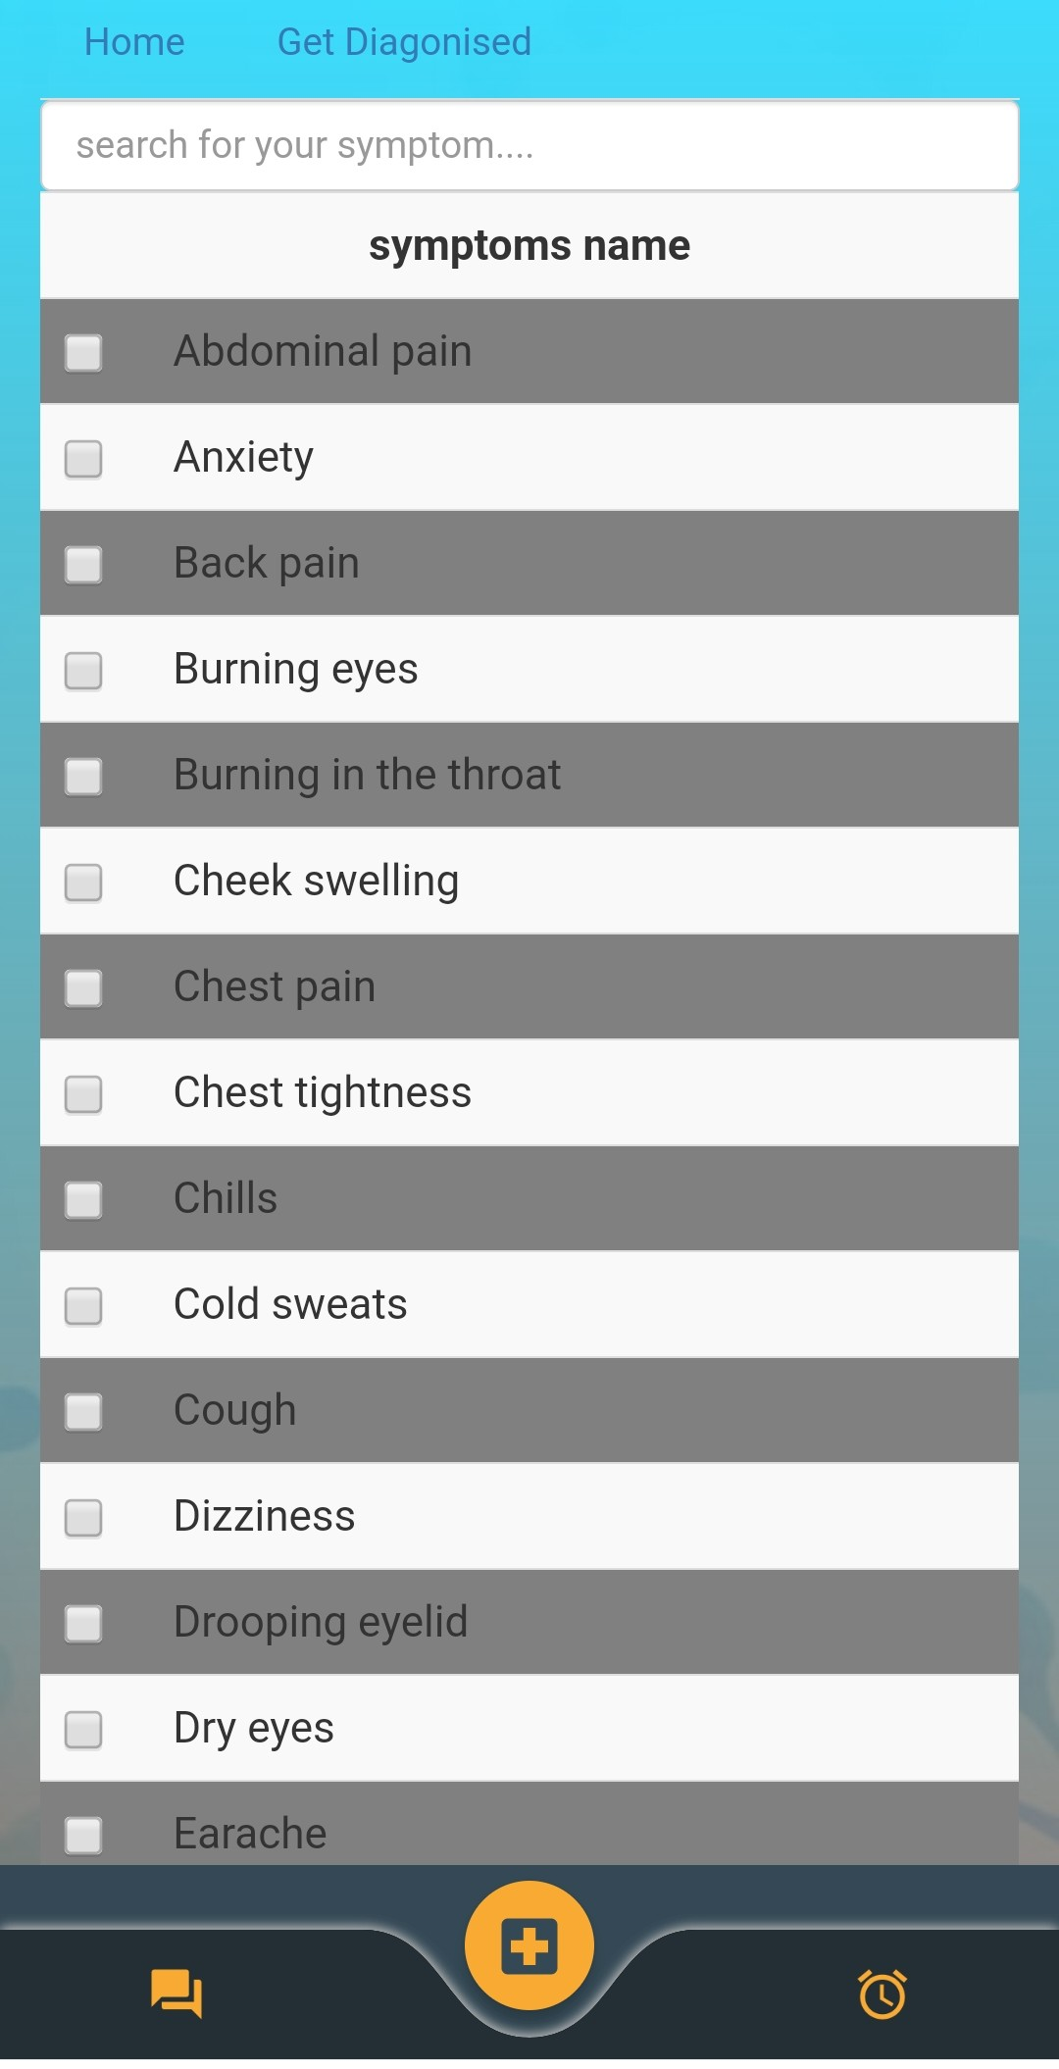
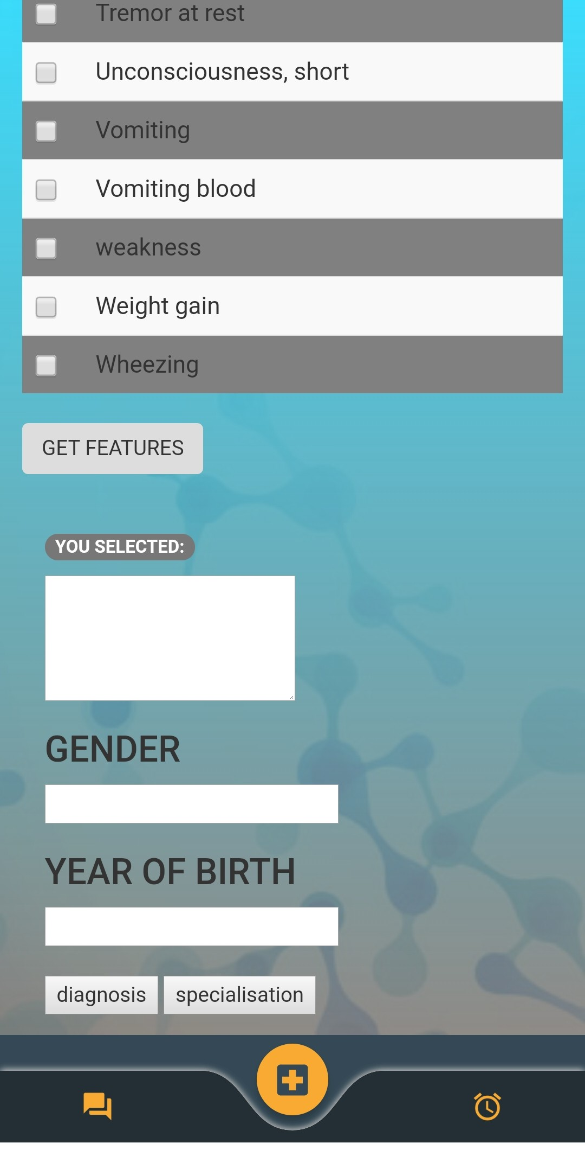
Module 2
Form Activity
Symptoms name
Parameters
Displays symptom names which can be selected by user
User needs to enter the parameters to get diagnosis

Slide 12
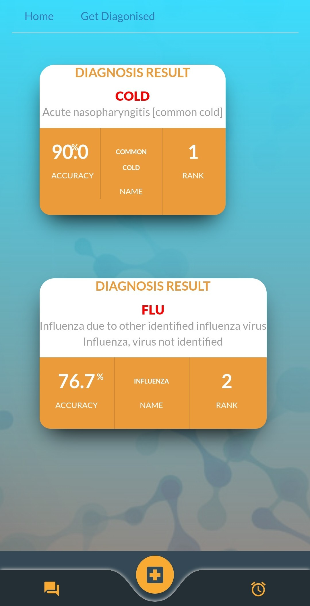
Module 3
Diagnosis Activity
Results
Displays possible diseases with accuracy

Slide 13
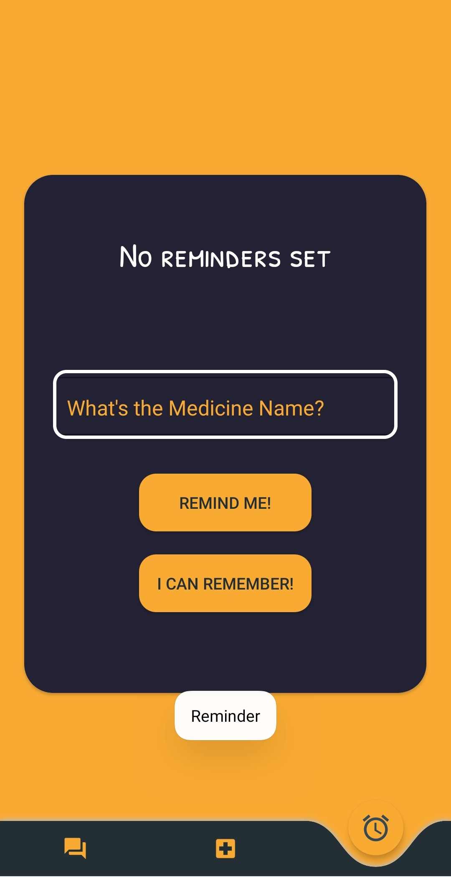
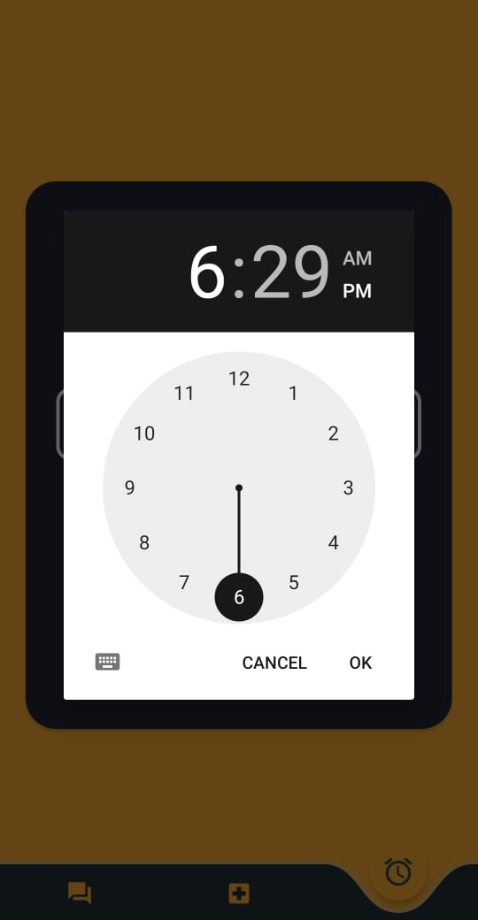
Module 4
Reminder Activity
Medicine name
Time picker
User can enter the medicine name which is need to reminded
Helps the user to set the time

Slide 14
Algorithm

Slide 15
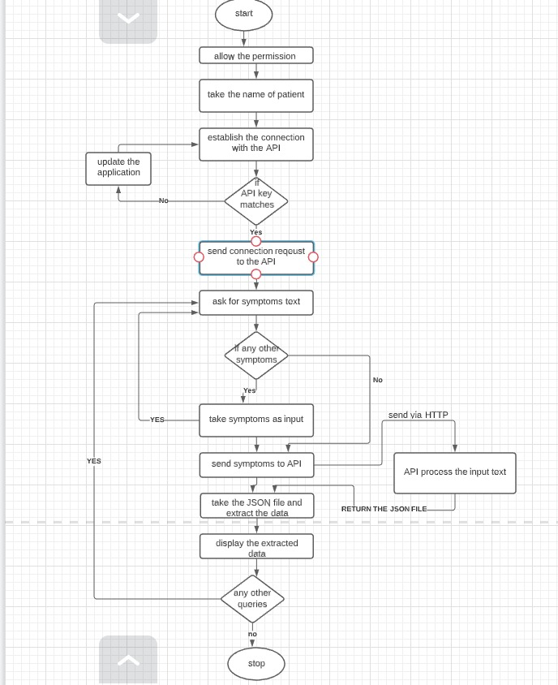
Flow chart diagram
(Pictorial Representation
Of Algorithm )

Slide 16
Architecture

Slide 17
View Headlines
Get Location
Make API Call
newapi/org/v2
Parse
Received Jason
Start
Get Diagnosed
Get Symptoms
Make API calls
developer.intermedica.com
Parse
Received Jason
Display Data On UI
User
Set Reminder
Get Medicine Name
Get Time
Get current time = reminder time
Reminder User

Slide 18
Uml diagrams

Slide 19
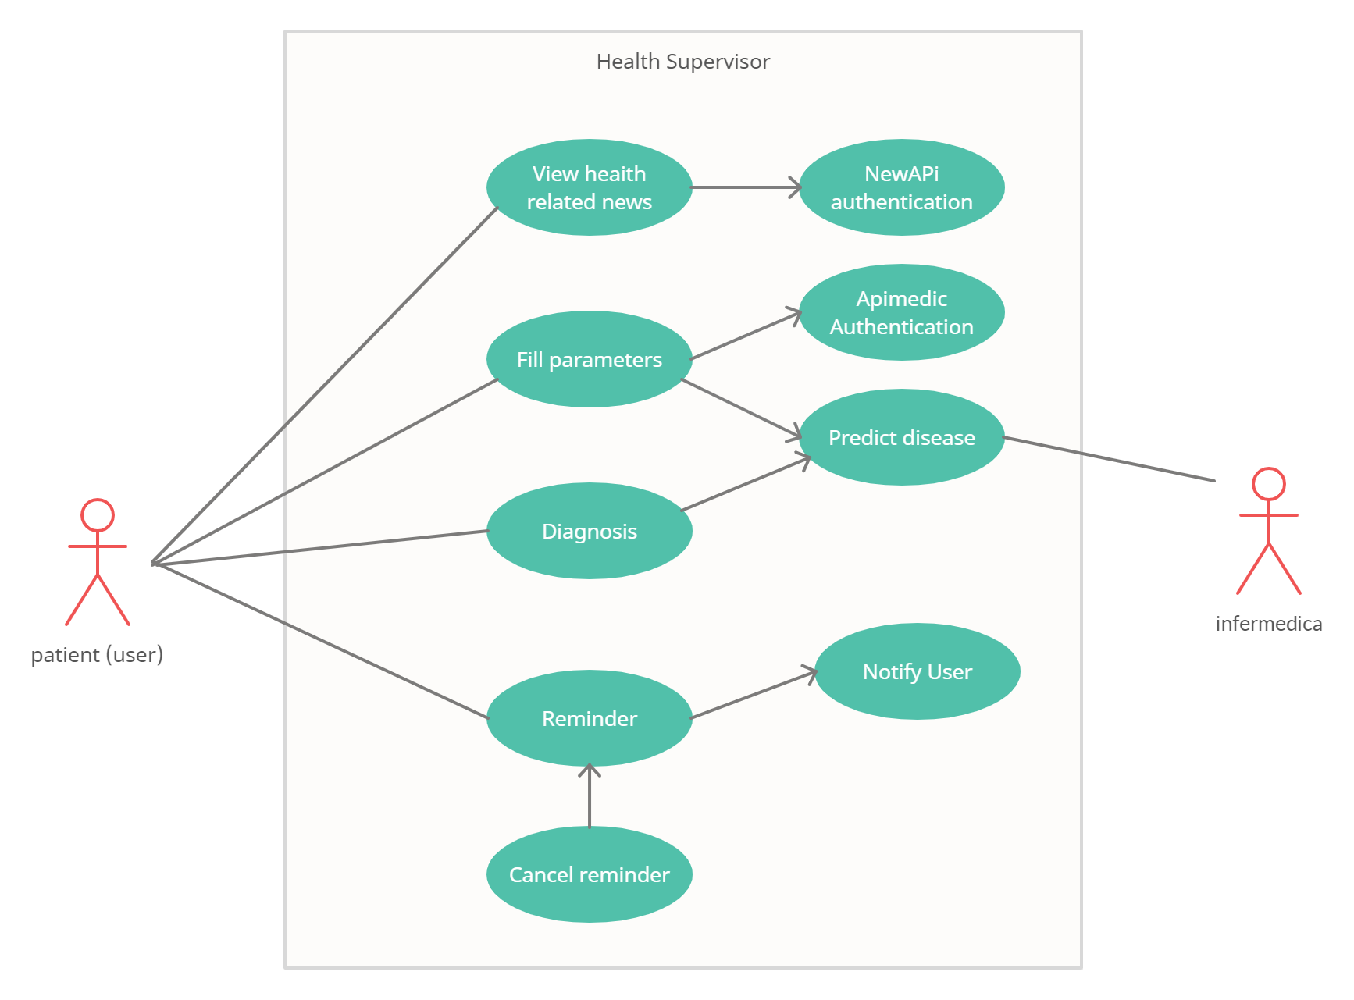
Use Case diagram

Slide 20
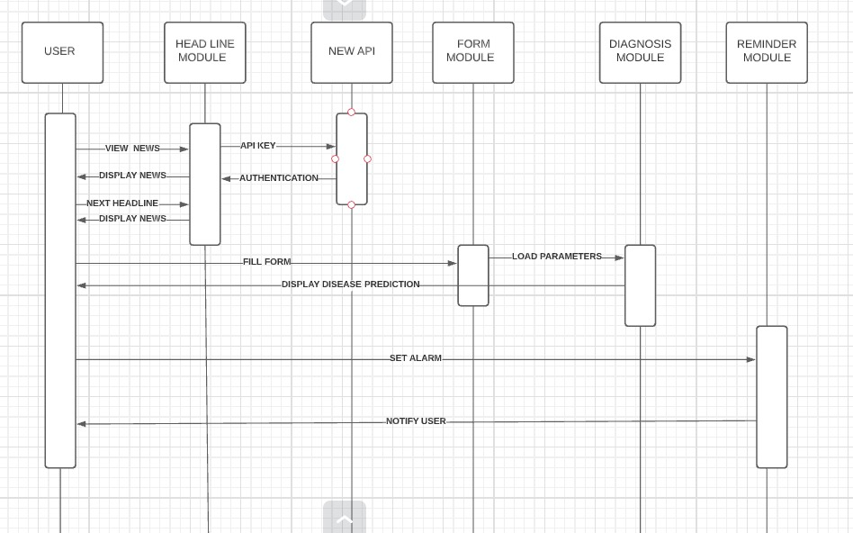
Sequence diagram

Slide 21
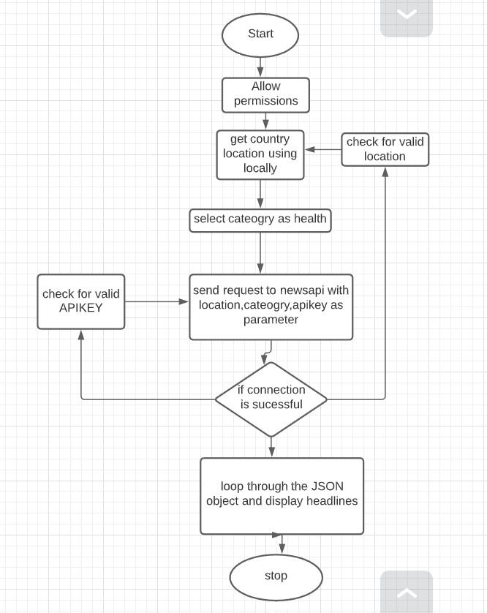
Flow chart diagram

Slide 22
Output

Slide 23
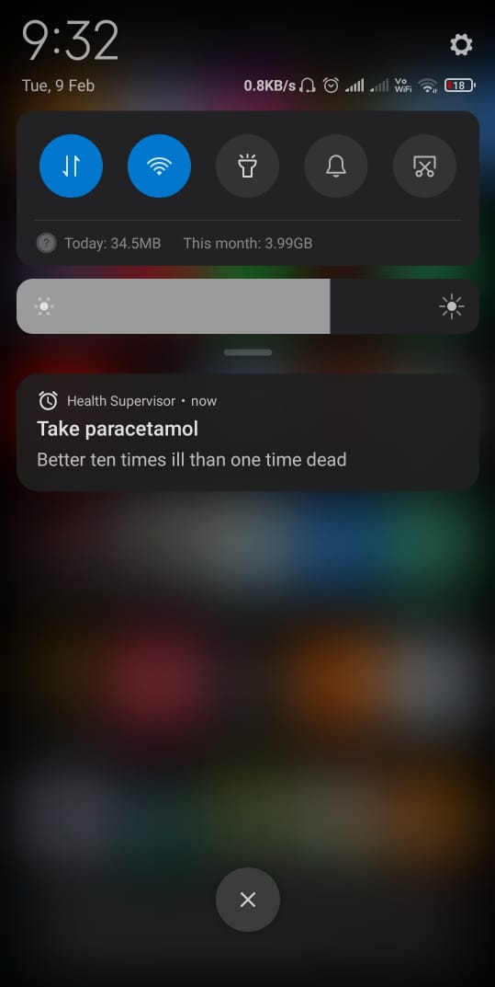
Disease prediction
Reminder Notification

Slide 24
Hardware Requirements
System Requirements
Processor | Intel i5 or above (works on i3 also but very poor performances)
Ram | 4 GB RAM minimum, 8 GB RAM recommended
Hard disk | 50 GB
System Type | 64 bits
Peripherals | Mouse , keyboard and monitor

Slide 25
Software Requirements
System Requirements
Operating System | Window Xp ,7,8,10.
IDE | Android Studio 4.1
JDK | Version 8
Language used | Java and xml
Android version | Lollipop 5.0

Slide 26
Literature Survey
Disease Prediction System
Aditya Tomar
The world is moving with a fast speed and in Order to keep up ourselves with the whole world we tend to ignore the symptoms of disease which can affect our health at a large extent. Many working professional’s get heart attack, bad cholesterol, eye disease and they are unable treat it at right time as they are busy coping up with progressive world. God has granted each and every individual a beautiful gift called life, so it is our responsibility to live our life to fullest and try to stay safe from the dangers of the world. So we have developed a logistic regression model with the help of machine learning algorithms like decision tree, random forest and naïve Bayes which take into account the symptoms felt by person and according to that symptoms it predicts the disease which the person can be suffering from. It saves time as well as makes it easy to get a warning about your health before it’s too late

Slide 27
Literature Survey
Smart Health Care System Implemented Using Internet of Things
Deepthi D. Kulkarn
Internet of Things (IOT) is the advanced connectivity of network infrastructure transportation and technology. Diagnosis and monitoring of health is very important tasks in healthcare industry. IOT smart devices are used to utilize the facilities of remote health monitoring and emergency notification system. Due to time consumption people do not opt to visit hospitals for small issues and later which may lead to hazardous health disease. Hence healthcare systems have emerged to analyze and predict the health of the patients by which people who don’t have time in their busy schedule can also monitor their health sitting in home at regular intervals. Many studies show that early diagnosis is thebest way to cure which will help and alert the patients to know the health status. This survey paper introduces that how IOT helps in various healthcare systems. The IOT based healthcare has emerging technique which excludes from the traditional healthcare and entire medical system. Hence the patient can check their medical record; the system gives a Better HealthCare to everyone with errorless and noiseless communication to patients

Slide 28
References
https://developer.android.com/reference
https://developer.infermedica.com/
https://developers.google.com/android/guides/setup
https://github.com/ybq/Android-SpinKit
https://newsAPI.org/docs
https://www.javatpoint.com/android-tutorial
https://github.com/square/picasso
https://github.com/mreram/ShowCaseView
https://github.com/ocpsoft/prettytime
https://material.io/develop/android
https://sandbox-authservice.priaid.ch/docs.html

Slide 29
Future Scope
In future the following features can be added into the model:
• Improving the search for symptoms.
• Making a detailed report and possibly a medical certificate and mail to the patient.
• Providing medications to the user for the predicted disease.

Slide 30
Conclusion
With the help of external API i.e. APImedic & Infermedica API the application is made so that the user can select his symptoms and these symptoms would be sent to the API and the all the predicted diseases with their chances will be displayed to the user. A total of 63 symptoms are put into consideration in building the model. Natural language processing has been implemented so that the user’s context and intention is understood and the particular keywords are chosen and sent as symptoms to the API. Important keywords like fever, cough, body pain etc. This is compared with the database which is stored in the backend for filtering out the appropriate symptoms based on the search. And with the help of NewsAPI the application could be able to display the latest top headlines in the medical field so that there’s awareness among the users.

Slide 31
Thank you

